Slide 1

Class 1

Slide 2
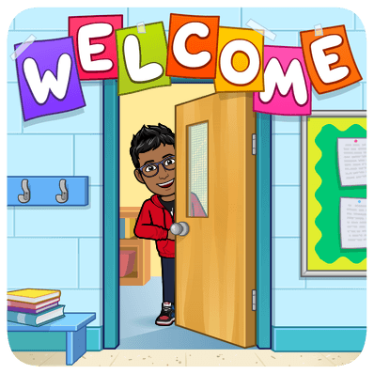
Thank you for joining!

Slide 3



About Me
My name is Raghav Krishna Ranganathan. Most people call me Raghav, but you guys can call me RK.
I am an 8th Grader at Odle Middle School, and I live in Bellevue, Washington, USA. I love coding and spend pretty much 3 hours a day coding and making new programming, and now that I’m teaching you guys, it probably a lot more! I’m very talkative, so bear with me.
I am so excited to teach you guys!

Slide 4
Class Rules and Quick Briefing
I’m not really a rules kind of guy, but there are some things you must follow and know.
Classes will have Classwork, and Homework. At the last week, I will assign a final HW project which will test all their skills. I expect you to finish your HW. It is the only way I can assess you out of class. If you don’t complete the HW, it will be very hard for you to progress in class, and I will not be able to help you catch up. All HW will be submitted on Teams. Assignments will be posted in the assignments channel. You will submit assignments in the private assignments channel between you and me that is named as “Assignments (Your Name)”.
If you have a question… PLEASE raise your hand. We will be using Teams… so you have the option to do that. If you have a personal question, please private chat me on Teams.
No side chatter. And no side chatting either. We will review previous homework for 5 to 10 mins. We will have a 7-minute break, at 45 mins from the start. IF at the end of the class, we have some extra time… you can side chat and have some fun.
Homework will be reviewed in class… so you cannot expect to always have extra time. If disruption keeps occurring throughout the class, and we must go over the ending time… I WILL GO OVER… I have made the content to fit into the timing, and if that won’t happen because of disruptions, I won’t let you go until we finish the content.

Slide 5

Class Rules and Quick Briefing (continued)
Please be on time to class. You can be 5 to 7 minutes late… but any minute after that… you will be prompted why. If it is an emergency, you will be excused. 4 late classes, and you won’t get anymore catch-up help from me, I’m sorry for being like this, but I cannot wait for students to catch up, since I want to fit all of this into 8 classes.
Announcements will be in the General Channel. Some will be in different categories depending on what they are.
As said before you can see what the assignment is in the public channel and submit them in the private one.
We will learn how to submit HW at the end of class!
That’s pretty much it… if you follow these rules… you’re set!
Now for some Python!

Slide 6
Things We’ll Cover
Basic Data Types Overview
Variables
Printing
Boolean
Comments
Strings and Numbers
Main Operators
File Handling
And More…
Lists
Tuples
If and Else
While and For loops
Functions
Casting
Turtle Graphics

Slide 7
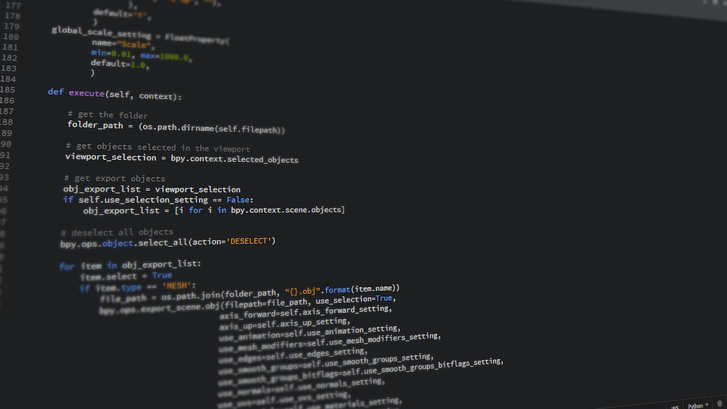
Intro to Python
Python is a popular programming language. It was created by Guido van Rossum and released in 1991.
It is used for:
web development (server-side)
software development
mathematics
system scripting
calculations

Slide 8
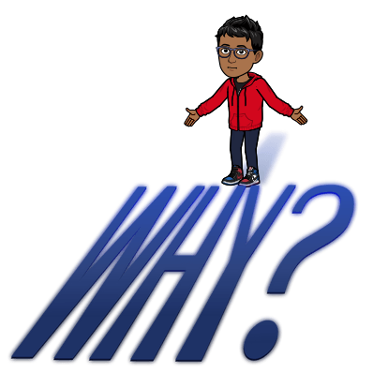
What can Python do? Why Python?
Python can be used on a server to create web applications.
Python can be used alongside software to create workflows.
Python can connect to database systems. It can also read and modify files.
Python can be used to handle big data and perform complex mathematics.
Python works on different platforms (Windows, Mac, Linux, Raspberry Pi, etc.).
Python has a simple syntax similar to the English language.
Python has syntax that allows developers to write programs with fewer lines than some other programming languages.
Python runs on an interpreter system, meaning that code can be executed as soon as it is written. This means that making a program and testing it can be very quick.
Python can be treated in a procedural way, an object-oriented way or a functional way.

Slide 9
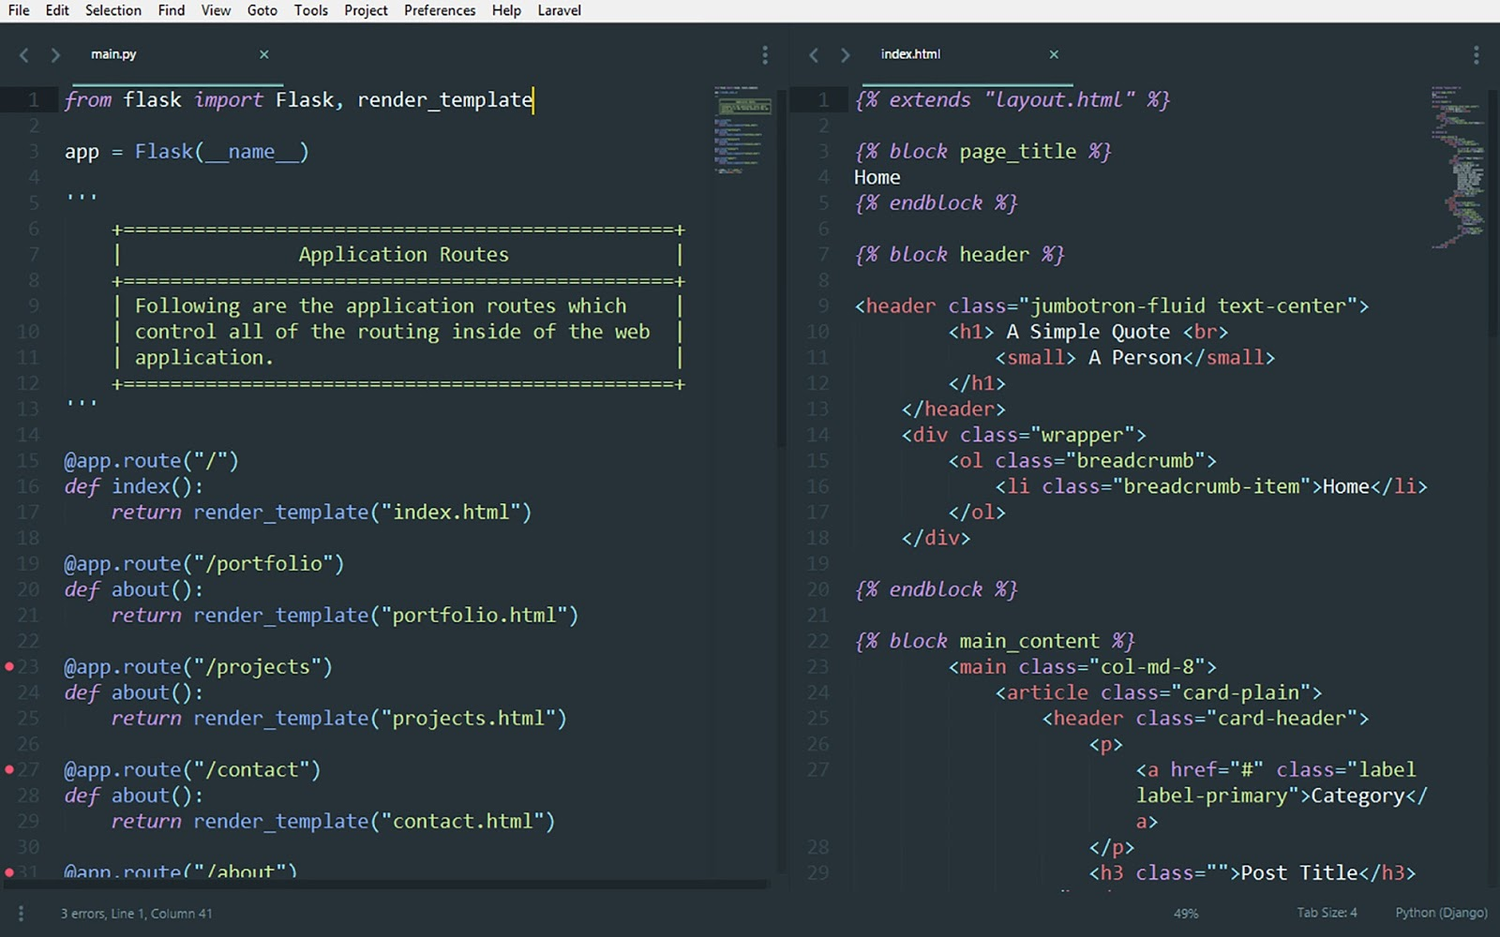

Good to Know
The most recent major version of Python is Python 3, which we shall be using in this class. However, Python 2, although not being updated with anything other than security updates, is still quite popular.

Slide 10
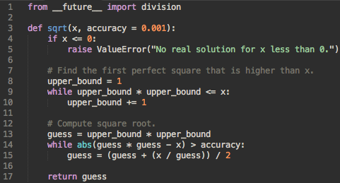

Python Syntax compared to other languages
Python was designed for readability and has some similarities to the English language with influence from mathematics.
Python uses new lines to complete a command, as opposed to other programming languages which often use semicolons or parentheses.
Python relies on indentation, using whitespace, to define scope; such as the scope of loops, functions and classes. Other programming languages often use curly-brackets for this purpose.

Slide 11

Setting up for Python
For this class we will be using an Online IDE called repl.it!
An IDE, or Integrated Development Environment, enables programmers to consolidate the different aspects of writing a computer program.
This means it will help you through learning the language by providing real-time tips on what options you can put in a segment of the program. Repl.it also gives us a user interface, which you can use to test your program, and see the output. This Online IDE is completely free, and the next steps will teach you how to make an account.

Slide 12
Setting up for Python (continued)
First type in repl.it in the google search bar and hit enter. (please use chrome)
Click on Sign Up in the top right corner…
Click on Sign up with google and sign up with personal google account or something else.
Once you have signed in… send me your username in the teams chat…. and I will add you to a team.
Once you have completed the steps …. Raise your hand.
Once all hands are raised, we will move on.

Slide 13
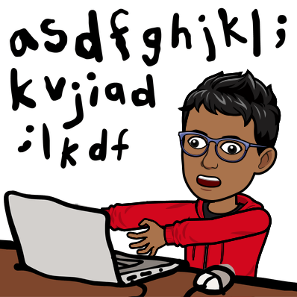
Time to learn some Python!

Slide 14
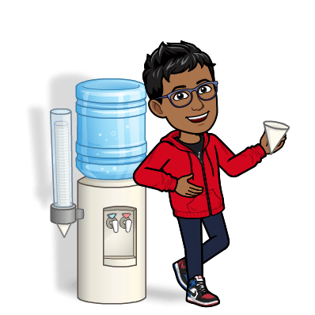
Data-Types (Text)
There are 7 types of data-types. And 4 basic ones, which we will review in this course.
Let’s look at the first one, Text Datatype.
There is only one datatype in this category…
String
I’ll switch over to repl.it and brief over it.
Let me also show you how to make a repl in repl.it. Follow along!

Slide 15

Data-Types (Numeric)
Now that you know the text data-type and know how to make a project… let’s see numeric data-types.
There are three datatypes in this category…
Integer, Float, and Complex.
We won’t see complex today… because it’s…
a little…
COMPLEX. (sorry bad pun)
Let’s see these in repl.it!

Slide 16

Data-Types (Sequence)
Now that you know the numeric data-types …. let’s see sequence data-types.
There are three datatypes in this category…
Tuple, List, Range.
Range will not be reviewed in this class.
Let’s go and brief these in repl.it.

Slide 17
Data-Types (Boolean)
Let’s see Boolean now.
There is only 1 datatype in this category…
Boolean
Let’s go and brief over it in repl.it.

Slide 18

More Data-Types
We have just briefed over the basic datatypes. There is a lot more to learn. We will learn these throughout the course and a lot more. This is bound to help you get started on python. Now let’s review HW.

Slide 19

Homework
I know that all of you totally enjoy doing Homework.
But we have got to have it so I can see how much you have progressed.
Let’s review the HW for this class. And let me explain how you will submit it.

Slide 20

Thank You!

